Slide 1
Airbnb
Pricing Analytics
Kelly Kim
Alexander Quang
Chuandong Liu
Woolim Lee
Notes:
@mary

Slide 2
Table of Contents
01
Business Problem
Our Process
03
Our Challenges
Key Insights
02
04
What business problem we are analyzing and solving
The analysis of our business problem using different models
The challenges we came across during our process
Our conclusions from our analysis of our business problem
Notes:
@mary

Slide 3
Business Problem
Airbnb
Consumers always have to face uncertainty and risks when predicting future Airbnb prices. We have created models to help consumers predict future airbnb prices.
Notes:
@mary

Slide 4
Business Problem
Topic
Focus
Predicting Airbnb prices with growing demand to help potential renters
Analyze information about various listings, hosts, accommodations, and customer reviews
Targeting one city (Sydney) to narrow project scope for models
Models can be used by consumers to predict the future prices of potential listings
Notes:
@mary

Slide 5
Our Challenges
Data
01
Lack of Resources
02
Limited Knowledge
03
Initially, our team filtered the dataset to New York and ran a linear regression that presented a low R-squared value of 0.18, which we deemed as unviable for analysis.
Not having enough time on discovering valuable datasets was a caveat during our research process.
We were unsuccessful in cleaning the datasets in a cohesive manner to obtain a high R-squared value due to our limited knowledge and experience.
Notes:
@kelly

Slide 6
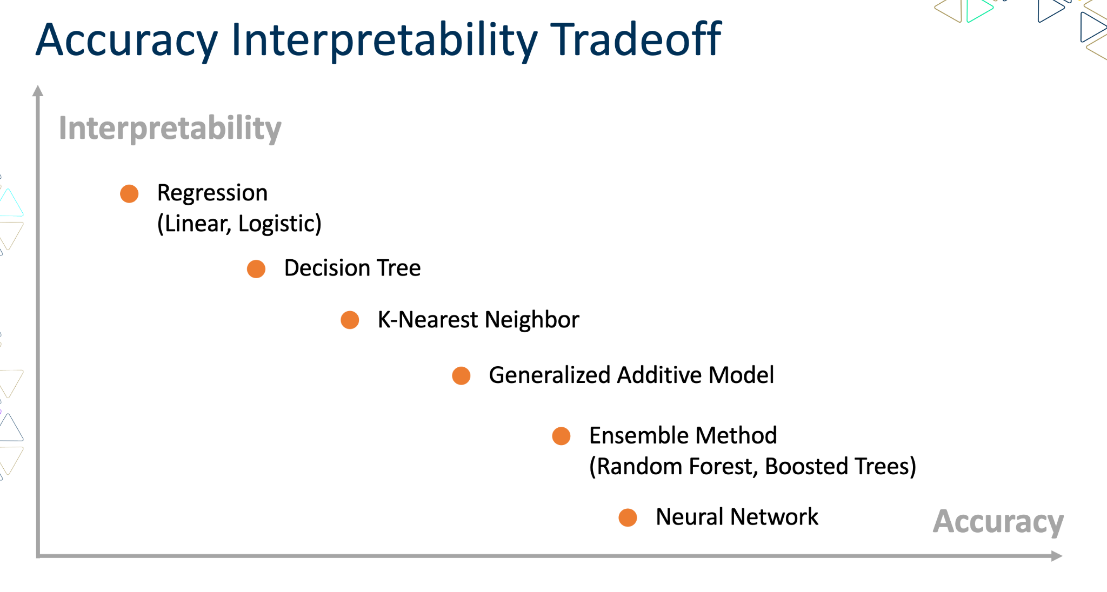
Our Process
Based on the accuracy-interpretability graph, we will begin making models that are the most interpretable and move towards accuracy.
Linear Regression
Random Forest
Gradient Boosted
Trees
Neural Network
Notes:
@mary

Slide 7
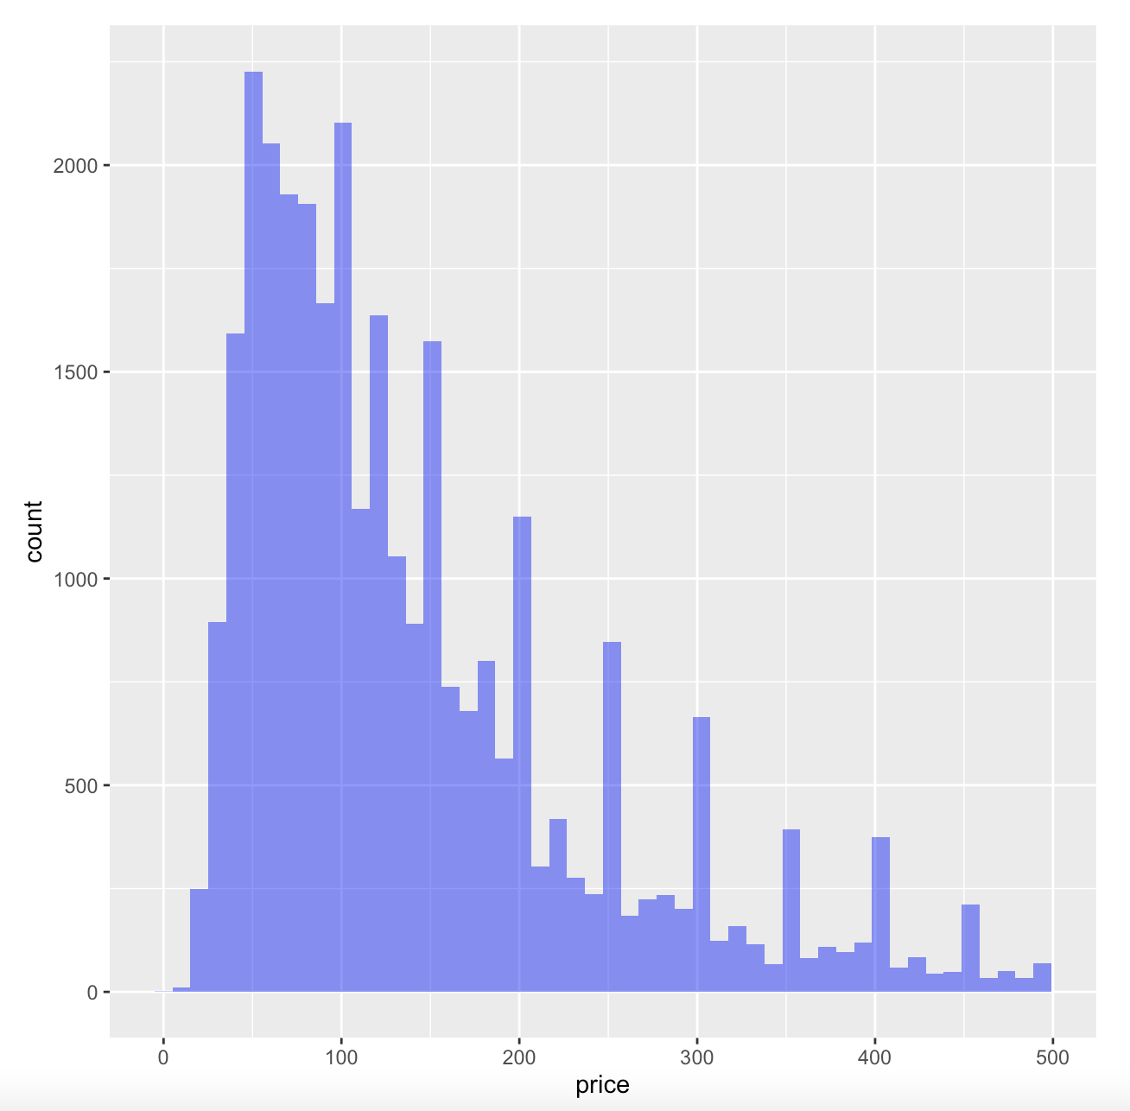
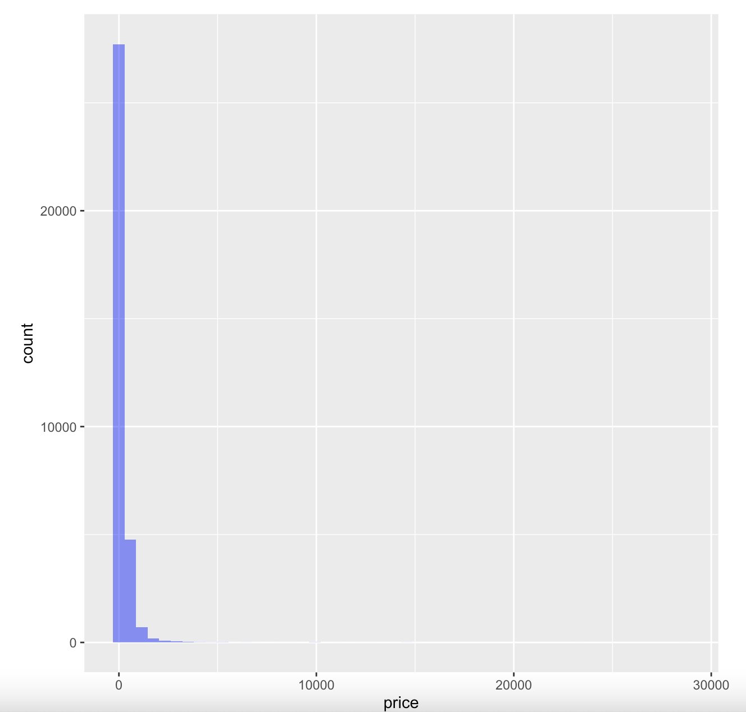
Data Overview: Airbnb Price
Notes:
@ chuandong

Slide 8
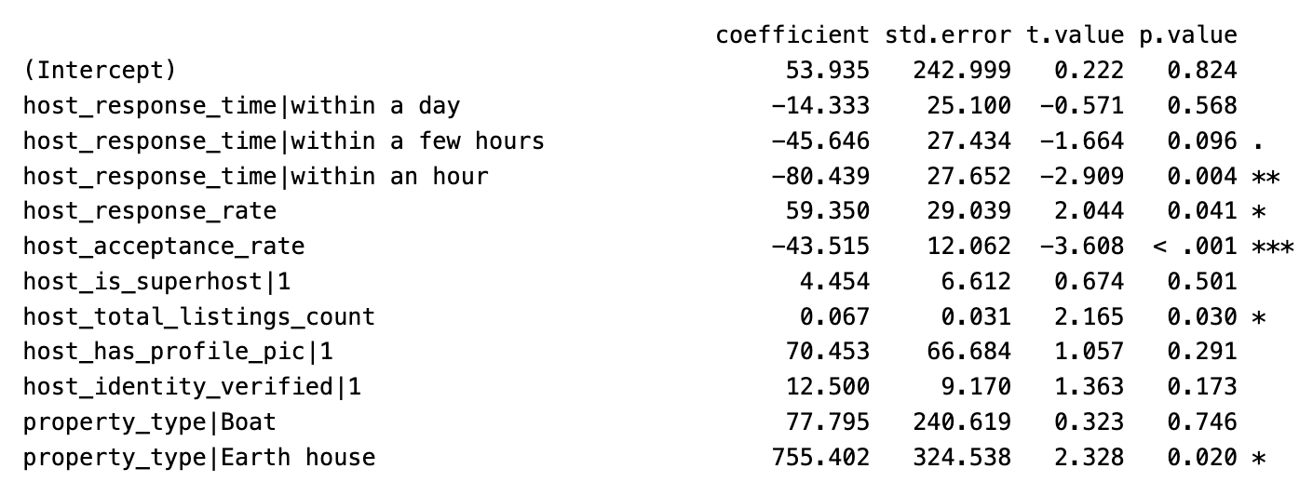
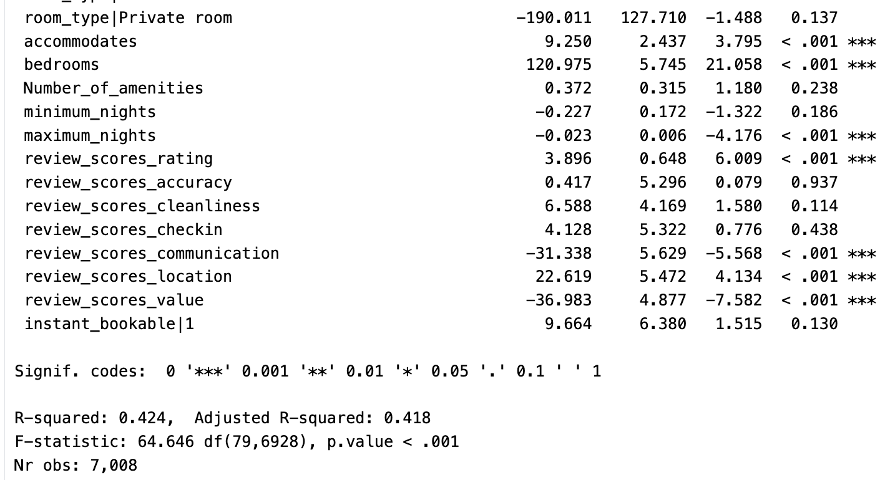
Models: Linear Regression
Notes:
@kelly
Host acceptance rate, accommodates, bedrooms, maximu_nights, review_scores_rating, review_scores_communication, review_scores_location, review_scores_value

Slide 9

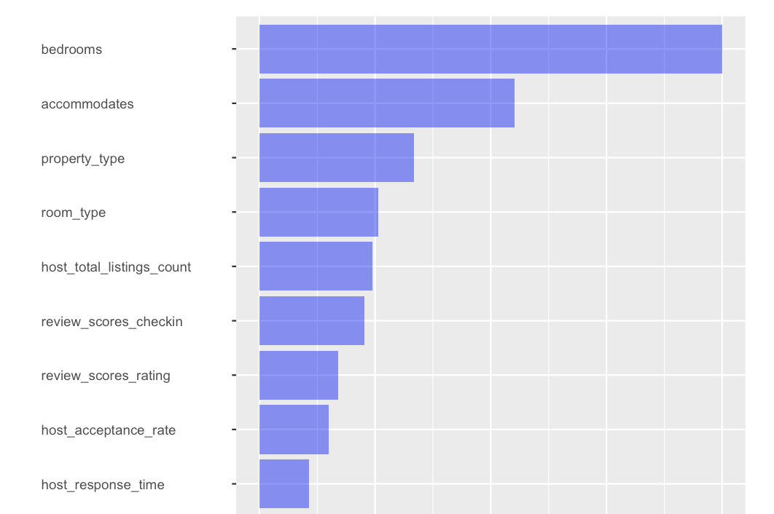
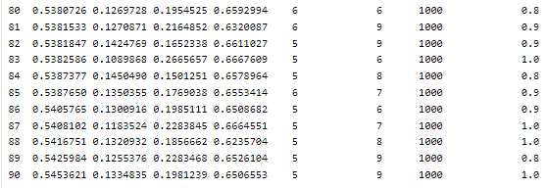
Models: Random Forest
cv.rforest(result, K=10, mtry = seq(2,7,1), min.node.size = seq(4, 9, 1), sample.fraction = seq(0.8,1, 0.1), fun=Rsq)
Notes:
@alex

Slide 10
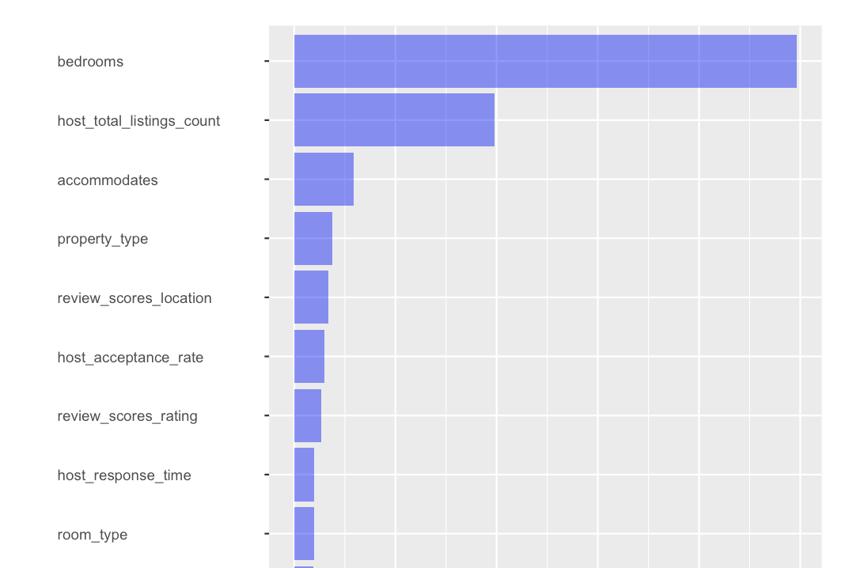
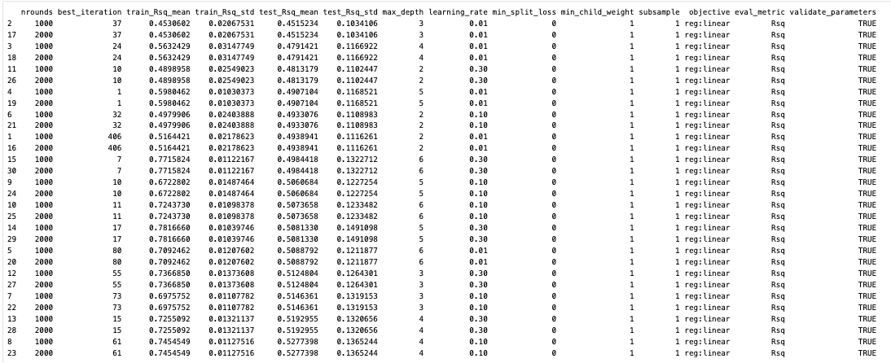
Models: Gradient Boosted Trees
cv.gbt(result, K = 10, params = list(max_depth = 2:6, learning_rate = c(0.01, 0.1, 0.3), nrounds=c(1000, 2000)), fun=Rsq, maximize = TRUE)
Notes:
@alex

Slide 11
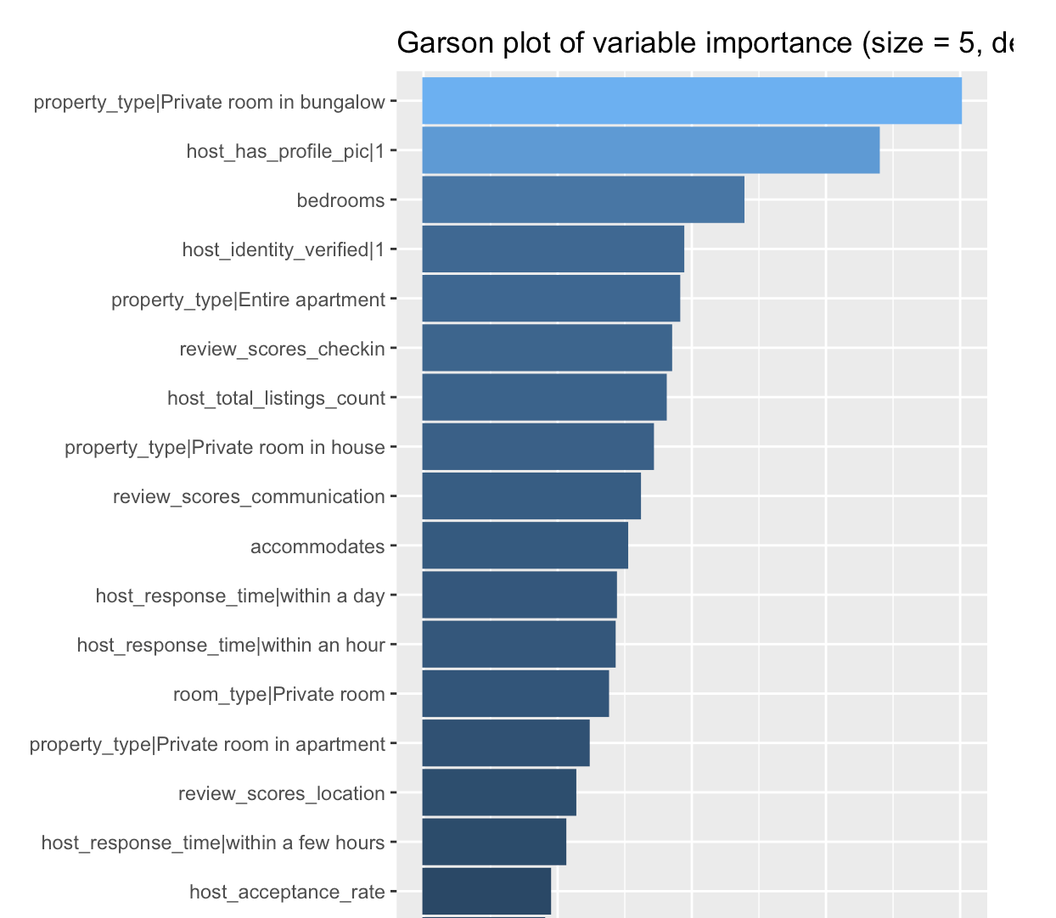
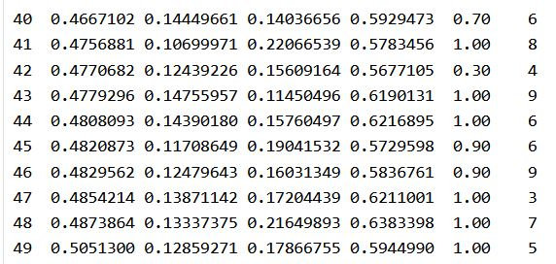
Models: Neural Network
cv.nn(result, K=10, decay =c(0.01,0.1,0.3,0.5,0.7,0.9,1.0), size = seq(3,9,1), seed=1, fun = Rsq)
Rsq (mean) std min max decay size
Notes:
@chuandong

Slide 12
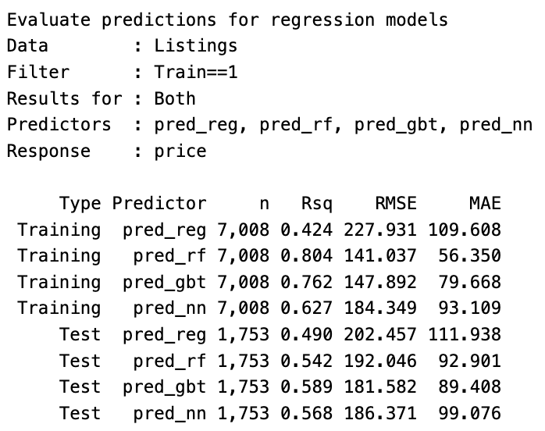
Comparison of Models
Overfitting
Lowest MAE value Highest R-square for validation
Middle R-squared on Validation & High MAE
Notes:
@chuandong

Slide 13
Key Insights
02
Gradient Boosted Trees
Common Factors
01
Test on Accuracy
Highest R-squared in the validations set along with the lowest MAE
Most significant variables
Bedrooms (+)
Host’s total listings (+)
Accomodations (+)
Variables that significantly affect price across the four models:
Accomodations
Bedrooms
Host acceptance rate
Host’s total listing
Review scores rating
Property Type
Notes:
@kelly

Slide 14
Real World Implications
We can cater our analytical solution to consumers that want to find the best deal on rental properties or short-term homes.

Slide 15
THANKS
References: https://www.kaggle.com/mysarahmadbhat/airbnb-listings-reviews (Filter: city == “Sydney”)
https://investorplace.com/2022/04/abnb-stock-is-rising-on-the-hope-of-summer-vacation-breakout/

